Slide 1
Design and Analysis of Algorithm
UNIT-III
Dynamic Programming
M Yogi Reddy
Assistant Professor,
Dept. of CSE,
School Of Technology,
GITAM(Deemed to be ) University,
Hyderabad.

Slide 2

Dynamic Programming Applications
Multistage graphs
All pairs shortest paths
Optimal binary search trees
Reliability design
Travelling sales person problem

Slide 3
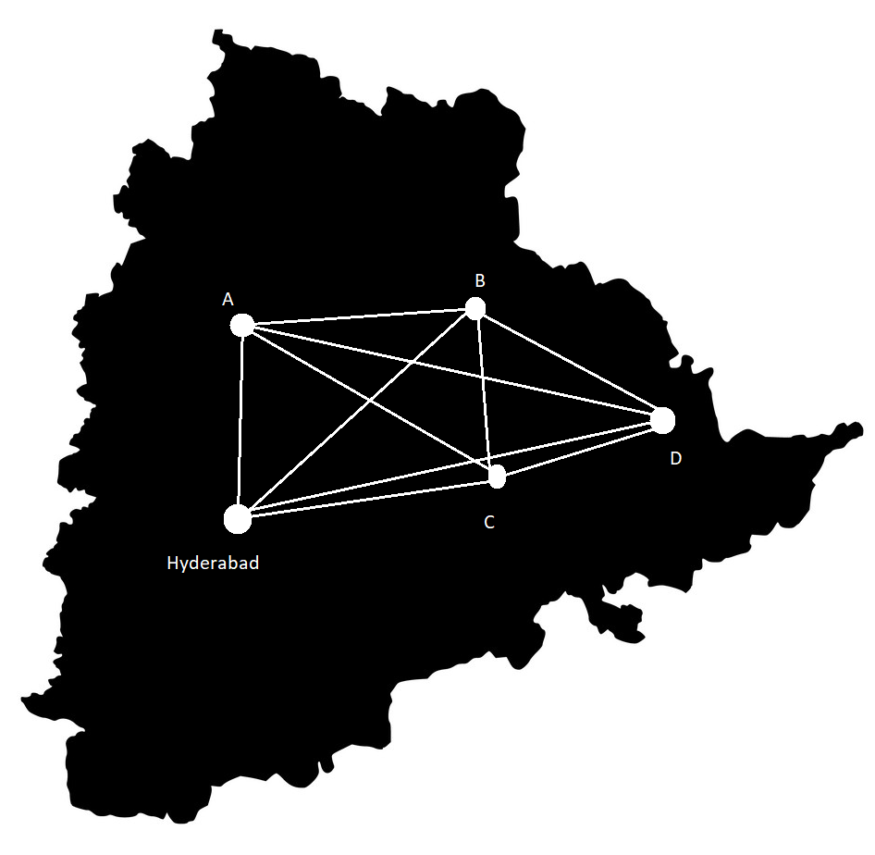
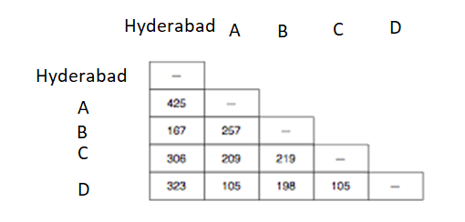
Travel
Suppose you decide to drive car around Telangana and you start your journey from Hyderabad
how can you minimize the number of kilometers yet make sure you visit all the cities?

Slide 4
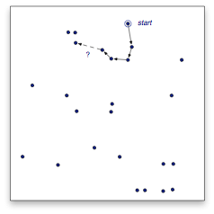
Tour
Since there are only five cities it’s not too hard to figure out the optimal tour
One way to find the optimal tour is to consider all possible paths
As we add cities to our tour, however, it is much harder to figure out the optimal tour
There is a problem with the exhaustive search strategy
the number of possible tours of a map with n cities is $(n − 1)! / 2$
the number of possible tours of a map with n cities is (𝑛 − 1)! / 2
#cities | #tours
5 | 12
6 | 60
7 | 360
8 | 2,520
9 | 20,160
10 | 181,440

Slide 5
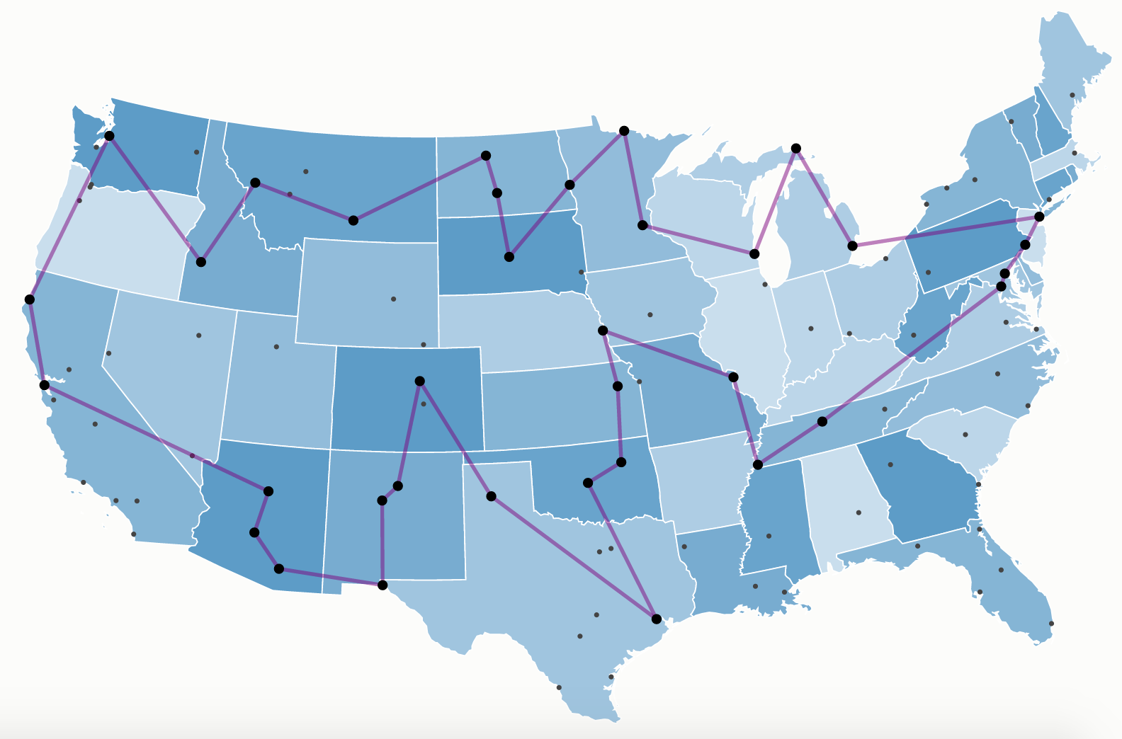
Problem Statement
Definition
A traveler needs to visit all the cities from a list, where distances between all the cities are known and each city should be visited just once.
What is the shortest possible route that he visits each city exactly once and returns to the origin city?

Slide 6
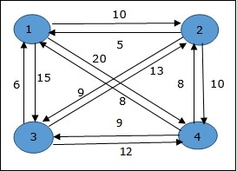
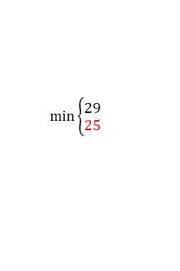
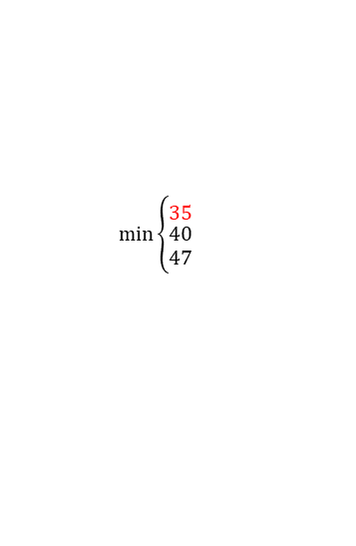


Example
The cost to visit from one to another city is given in the graph. Find the optimal route to visit from node 1 to all other once node and then come back to 1
$$min\left\{\begin{matrix}35 \\ \begin{aligned}40 \\ 47\end{aligned}\end{matrix}\right.⁡$$
1
$$min\left\{\begin{matrix}31 \\ 25\end{matrix}\right.⁡$$
$$min\left\{\begin{matrix}29 \\ 25\end{matrix}\right.⁡$$
2
3
4
$$min\left\{\begin{matrix}24 \\ 27\end{matrix}\right.⁡$$
12+8=20
3
4
2
4
16
2
3
18
15
18
13
4
3
4
2
3
2
8
6
8
5
6
5
It is brute force method
1
1
1
1
1
1

Slide 7

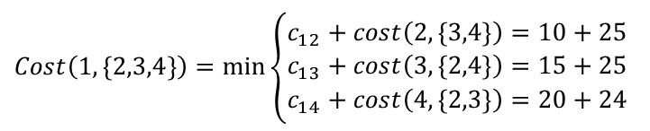

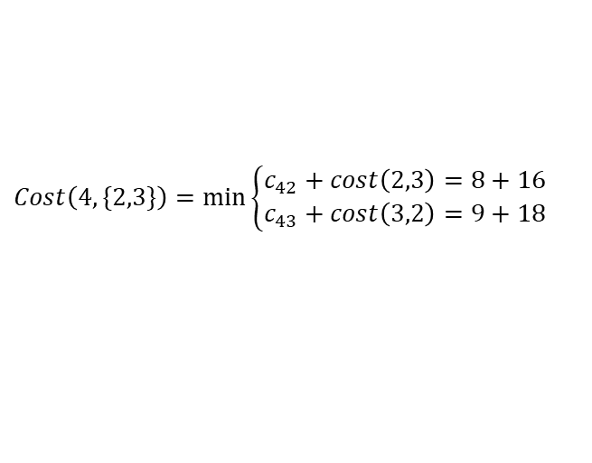


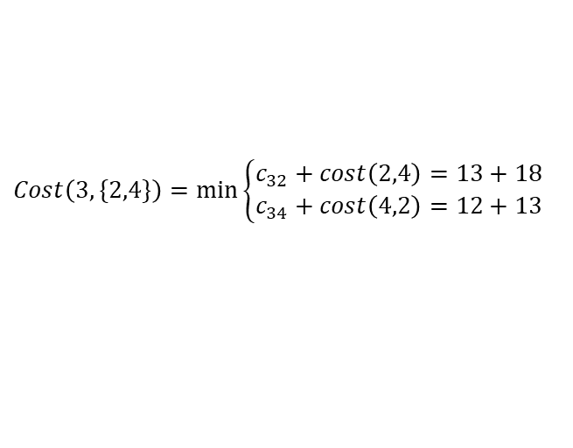

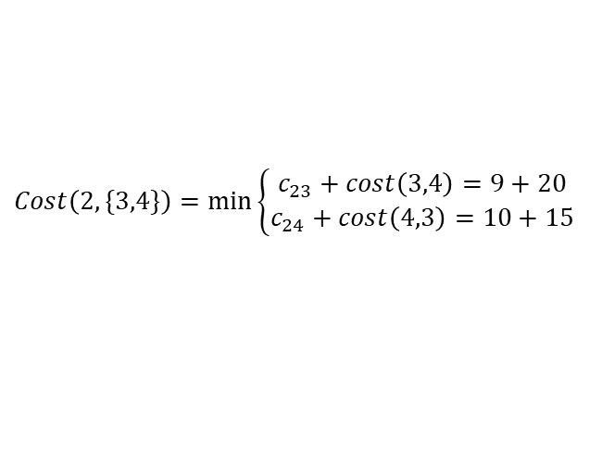
Mathematical Steps
$Cost\left(2,Φ\right)=5$, $Cost\left(3,Φ\right)=6$, $Cost\left(4,Φ\right)=8$,
$$Cost\left(3,\{4\}\right)=c_{34}+cost\left(4,Φ\right)=20$$
$$Cost\left(i,S\right)=\min_{j∈S}{\{c_{ij}+Cost(j,S−\{j\})\}}$$
$$Cost\left(4,\{3\}\right)=c_{43}+cost\left(3,Φ\right)=15$$
$$Cost\left(2,\{4\}\right)=c_{24}+cost\left(4,Φ\right)=18$$
$$Cost\left(4,\{2\}\right)=c_{42}+cost\left(2,Φ\right)=13$$
$$min\left\{\begin{matrix}35 \\ \begin{aligned}41 \\ 47\end{aligned}\end{matrix}\right.⁡$$
$$Cost\left(2,\{3\}\right)=c_{23}+cost\left(3,Φ\right)=16$$
1
$$Cost\left(3,\{2\}\right)=c_{32}+cost\left(2,Φ\right)=18$$
$$min\left\{\begin{matrix}31 \\ 25\end{matrix}\right.⁡$$
$$Cost\left(2,\{3,4\}\right)=min⁡\left\{\begin{aligned}c_{23}+cost\left(3,4\right)=9+20 \\ c_{24}+cost\left(4,3\right)=10+15\end{aligned}\right.$$
$$min\left\{\begin{matrix}29 \\ 25\end{matrix}\right.⁡$$
2
3
4
$$min\left\{\begin{matrix}24 \\ 27\end{matrix}\right.⁡$$
$$Cost\left(3,\{2,4\}\right)=min⁡\left\{\begin{aligned}c_{32}+cost\left(2,4\right)=13+18 \\ c_{34}+cost\left(4,2\right)=12+13\end{aligned}\right.$$
12+8=20
3
4
2
4
2
3
$$Cost\left(4,\{2,3\}\right)=min⁡\left\{\begin{aligned}c_{42}+cost\left(2,3\right)=8+16 \\ c_{43}+cost\left(3,2\right)=9+18\end{aligned}\right.$$
15
18
13
16
18
4
3
4
2
3
2
$$Cost\left(1,\{2,3,4\}\right)=min⁡\left\{\begin{aligned}\begin{aligned}c_{12}+cost\left(2,\{3,4\}\right)=10+25 \\ c_{13}+cost\left(3,\{2,4\}\right)=15+25\end{aligned} \\ c_{14}+cost\left(4,\{2,3\}\right)=20+24\end{aligned}\right.$$
8
6
8
5
6
5
1
1
1
1
1
1

Slide 8

Mathematical Steps
$Cost\left(2,Φ\right)=5$, $Cost\left(3,Φ\right)=6$, $Cost\left(4,Φ\right)=8$,
$$Cost\left(3,\{4\}\right)=c_{34}+cost\left(4,Φ\right)=20$$
$$Cost\left(i,S\right)=\min_{j∈S}{\{c_{ij}+Cost(j,S−\{J\})\}}$$
$$Cost\left(4,\{3\}\right)=c_{43}+cost\left(3,Φ\right)=15$$
$$Cost\left(2,\{4\}\right)=c_{24}+cost\left(4,Φ\right)=18$$
$$Cost\left(4,\{2\}\right)=c_{42}+cost\left(2,Φ\right)=13$$
$$Cost\left(2,\{3\}\right)=c_{23}+cost\left(3,Φ\right)=16$$
$$Cost\left(3,\{2\}\right)=c_{32}+cost\left(2,Φ\right)=18$$
$$Cost\left(2,\{3,4\}\right)=min⁡\left\{\begin{aligned}c_{23}+cost\left(3,4\right)=9+20 \\ c_{24}+cost\left(4,3\right)=10+15\end{aligned}\right.$$
1
2
4
3
1
$$Cost\left(3,\{2,4\}\right)=min⁡\left\{\begin{aligned}c_{32}+cost\left(2,4\right)=13+18 \\ c_{34}+cost\left(4,2\right)=12+13\end{aligned}\right.$$
$$Cost\left(4,\{2,3\}\right)=min⁡\left\{\begin{aligned}c_{42}+cost\left(2,3\right)=8+16 \\ c_{43}+cost\left(3,2\right)=9+18\end{aligned}\right.$$
$$Cost\left(1,\{2,3,4\}\right)=min⁡\left\{\begin{aligned}\begin{aligned}c_{12}+cost\left(2,\{3,4\}\right)=10+25 \\ c_{13}+cost\left(3,\{2,4\}\right)=15+25\end{aligned} \\ c_{14}+cost\left(4,\{2,3\}\right)=20+24\end{aligned}\right.$$

Slide 9
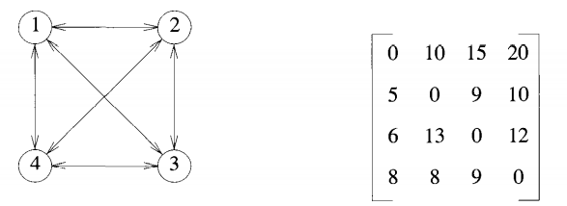


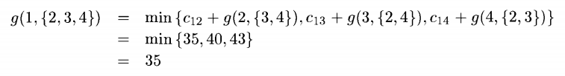
Question
The cost to visit from one to another city is given in the graph. Find the optimal route to visit from node 1 to all other once node and then come back to 1

Slide 10
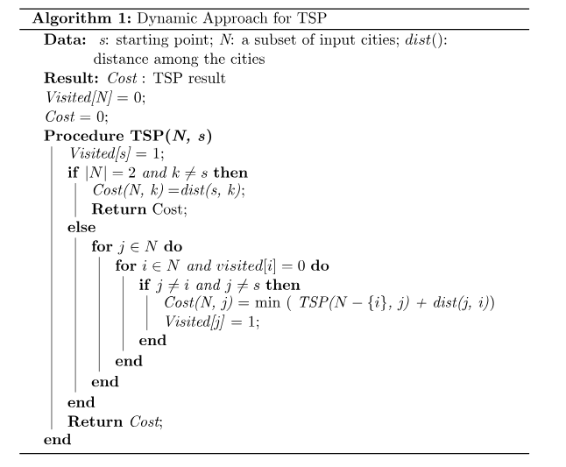
Algorithm(bottom up approach)
Time Complexity Analysis:
In the dynamic algorithm for TSP, the number of possible subsets can be at most N * 2^N.
Each subset can be solved in O(N) times.
Therefore, the time complexity of this algorithm would be O(N^2 *2^N)}.

Slide 11



